Slide 1
Factorial
4!

Slide 2
Factorial 4!
.section .data # this program has no global data
.section .text
.globl _start
.globl factorial # unneeded unless we want to
# share this function among
# other programs
_start:
pushl $4 # one argument only
call factorial # run the factorial function
addl $4, %esp # scrubs the parameter that
# was pushed on the stack
movl %eax, % ebx # factorial returns answer in
# %eax, but we want it in %ebx
# as exit status
movl $1, %eax # call kernel’s exit function
int $0x80 # interrupt 16

Slide 3

Factorial 4!
.section .data # this program has no global data
.section .text
.globl _start
.globl factorial # unneeded unless we want to
# share this function among
# other programs
_start:
pushl $4 # one argument only
call factorial # run the factorial function
addl $4, %esp # scrubs the parameter that
# was pushed on the stack
movl %eax, % ebx # factorial returns answer in
# %eax, but we want it in %ebx
# as exit status
movl $1, %eax # call kernel’s exit function
int $0x80 # interrupt 16
(%esp)$→$ | 4

Slide 4


Factorial main $→$ factorial
.section .data # this program has no global data
.section .text
.globl _start
.globl factorial # unneeded unless we want to
# share this function among
# other programs
_start:
pushl $4 # one argument only
call factorial # run the factorial function
addl $4, %esp # scrubs the parameter that
# was pushed on the stack
movl %eax, % ebx # factorial returns answer in
# %eax, but we want it in %ebx
# as exit status
movl $1, %eax # call kernel’s exit function
int $0x80 # interrupt 16
 | 4
(%esp)$→$ | return address

Slide 5
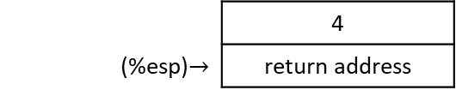
Factorial main $→$ factorial
.section .data # this program has no global data
.section .text
.globl _start
.globl factorial # unneeded unless we want to
# share this function among
# other programs
_start:
pushl $4 # one argument only
call factorial # run the factorial function
addl $4, %esp # scrubs the parameter that
# was pushed on the stack
movl %eax, % ebx # factorial returns answer in
# %eax, but we want it in %ebx
# as exit status
movl $1, %eax # call kernel’s exit function
int $0x80 # interrupt 16
 | 4
(%esp)$→$ | return address
.type factorial, @function # tell linker this will be a function
factorial:
# Prologue
pushl %ebp # save old base pointer
movl %esp, %ebp # make stack pointer the base pointer
movl 8(%ebp), %eax # move 1st argument into %eax
…
EIP = start of power function

Slide 6

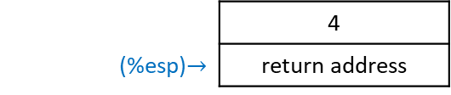
Factorial main $→$ factorial
.type factorial, @function # tell linker this will be a function
factorial:
# Prologue
pushl %ebp # save old base pointer
movl %esp, %ebp # make stack pointer the base pointer
movl 8(%ebp), %eax # move 1st argument into %eax
cmpl $1, %eax # base case so we return
# (return value %eax already 1)
je end_factorial
decl %eax # otherwise, decrease the value
pushl %eax # push it for our call to factorial
call factorial # call the factorial function
movl 8(%ebp), %ebx # %eax has return value so reload
# our parameter into %ebx
imull %ebx, %eax # multiply that by the last result
# of factorial, answer stored in
# %eax (already return value)
end_factorial:
# Epilogue
movl %ebp, %esp # restore stack pointer
popl %ebp # restore base pointer
ret # popl %eip
 | 4
(%esp)$→$ | return address
EIP = start of power function

Slide 7
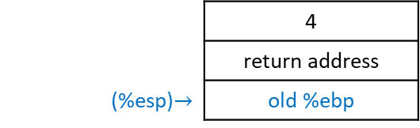

Factorial main $→$ factorial
.type factorial, @function # tell linker this will be a function
factorial:
# Prologue
pushl %ebp # save old base pointer
movl %esp, %ebp # make stack pointer the base pointer
movl 8(%ebp), %eax # move 1st argument into %eax
cmpl $1, %eax # base case so we return
# (return value %eax already 1)
je end_factorial
decl %eax # otherwise, decrease the value
pushl %eax # push it for our call to factorial
call factorial # call the factorial function
movl 8(%ebp), %ebx # %eax has return value so reload
# our parameter into %ebx
imull %ebx, %eax # multiply that by the last result
# of factorial, answer stored in
# %eax (already return value)
end_factorial:
# Epilogue
movl %ebp, %esp # restore stack pointer
popl %ebp # restore base pointer
ret # popl %eip
 | 4
 | return address
(%esp)$→$ | old %ebp
EIP = start of power function

Slide 8

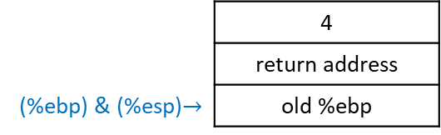
Factorial main $→$ factorial
.type factorial, @function # tell linker this will be a function
factorial:
# Prologue
pushl %ebp # save old base pointer
movl %esp, %ebp # make stack pointer the base pointer
movl 8(%ebp), %eax # move 1st argument into %eax
cmpl $1, %eax # base case so we return
# (return value %eax already 1)
je end_factorial
decl %eax # otherwise, decrease the value
pushl %eax # push it for our call to factorial
call factorial # call the factorial function
movl 8(%ebp), %ebx # %eax has return value so reload
# our parameter into %ebx
imull %ebx, %eax # multiply that by the last result
# of factorial, answer stored in
# %eax (already return value)
end_factorial:
# Epilogue
movl %ebp, %esp # restore stack pointer
popl %ebp # restore base pointer
ret # popl %eip
 | 4
 | return address
(%ebp) & (%esp)$→$ | old %ebp
EIP = start of power function

Slide 9
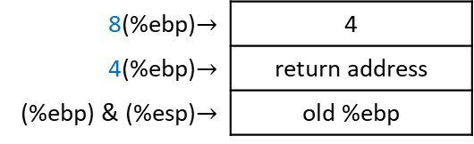
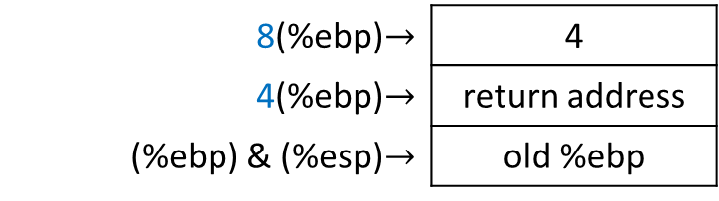
Factorial main $→$ factorial
.type factorial, @function # tell linker this will be a function
factorial:
# Prologue
pushl %ebp # save old base pointer
movl %esp, %ebp # make stack pointer the base pointer
movl 8(%ebp), %eax # move 1st argument into %eax
cmpl $1, %eax # base case so we return
# (return value %eax already 1)
je end_factorial
decl %eax # otherwise, decrease the value
pushl %eax # push it for our call to factorial
call factorial # call the factorial function
movl 8(%ebp), %ebx # %eax has return value so reload
# our parameter into %ebx
imull %ebx, %eax # multiply that by the last result
# of factorial, answer stored in
# %eax (already return value)
end_factorial:
# Epilogue
movl %ebp, %esp # restore stack pointer
popl %ebp # restore base pointer
ret # popl %eip
8(%ebp)$→$ | 4
4(%ebp)$→$ | return address
(%ebp) & (%esp)$→$ | old %ebp
EIP = start of power function

Slide 10
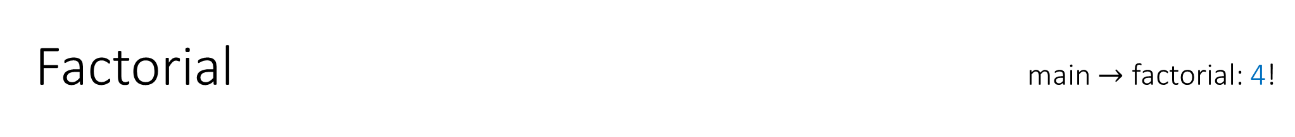
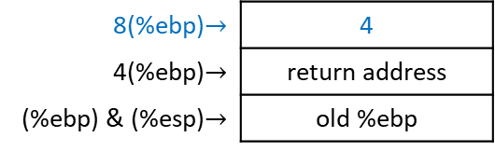
Factorial main $→$ factorial: 4!
.type factorial, @function # tell linker this will be a function
factorial:
# Prologue
pushl %ebp # save old base pointer
movl %esp, %ebp # make stack pointer the base pointer
movl 8(%ebp), %eax # move 1st argument into %eax
cmpl $1, %eax # base case so we return
# (return value %eax already 1)
je end_factorial
decl %eax # otherwise, decrease the value
pushl %eax # push it for our call to factorial
call factorial # call the factorial function
movl 8(%ebp), %ebx # %eax has return value so reload
# our parameter into %ebx
imull %ebx, %eax # multiply that by the last result
# of factorial, answer stored in
# %eax (already return value)
end_factorial:
# Epilogue
movl %ebp, %esp # restore stack pointer
popl %ebp # restore base pointer
ret # popl %eip
8(%ebp)$→$ | 4
4(%ebp)$→$ | return address
(%ebp) & (%esp)$→$ | old %ebp
EIP = start of power function
EAX = 4

Slide 11

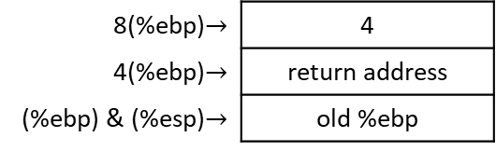

Factorial main $→$ factorial: 4?
.type factorial, @function # tell linker this will be a function
factorial:
# Prologue
pushl %ebp # save old base pointer
movl %esp, %ebp # make stack pointer the base pointer
movl 8(%ebp), %eax # move 1st argument into %eax
cmpl $1, %eax # base case so we return
# (return value %eax already 1)
je end_factorial
decl %eax # otherwise, decrease the value
pushl %eax # push it for our call to factorial
call factorial # call the factorial function
movl 8(%ebp), %ebx # %eax has return value so reload
# our parameter into %ebx
imull %ebx, %eax # multiply that by the last result
# of factorial, answer stored in
# %eax (already return value)
end_factorial:
# Epilogue
movl %ebp, %esp # restore stack pointer
popl %ebp # restore base pointer
ret # popl %eip
8(%ebp)$→$ | 4
4(%ebp)$→$ | return address
(%ebp) & (%esp)$→$ | old %ebp
EIP = start of power function
EAX = 4 = 1 ? $→$ false

Slide 12

Factorial main $→$ factorial: 4$∙$3!
.type factorial, @function # tell linker this will be a function
factorial:
# Prologue
pushl %ebp # save old base pointer
movl %esp, %ebp # make stack pointer the base pointer
movl 8(%ebp), %eax # move 1st argument into %eax
cmpl $1, %eax # base case so we return
# (return value %eax already 1)
je end_factorial
decl %eax # otherwise, decrease the value
pushl %eax # push it for our call to factorial
call factorial # call the factorial function
movl 8(%ebp), %ebx # %eax has return value so reload
# our parameter into %ebx
imull %ebx, %eax # multiply that by the last result
# of factorial, answer stored in
# %eax (already return value)
end_factorial:
# Epilogue
movl %ebp, %esp # restore stack pointer
popl %ebp # restore base pointer
ret # popl %eip
8(%ebp)$→$ | 4
4(%ebp)$→$ | return address
(%ebp) & (%esp)$→$ | old %ebp
EIP = start of power function
EAX = 3

Slide 13
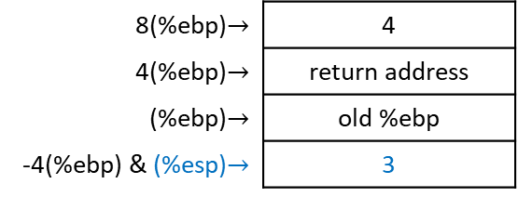
Factorial main $→$ factorial: 4$∙$3!
.type factorial, @function # tell linker this will be a function
factorial:
# Prologue
pushl %ebp # save old base pointer
movl %esp, %ebp # make stack pointer the base pointer
movl 8(%ebp), %eax # move 1st argument into %eax
cmpl $1, %eax # base case so we return
# (return value %eax already 1)
je end_factorial
decl %eax # otherwise, decrease the value
pushl %eax # push it for our call to factorial
call factorial # call the factorial function
movl 8(%ebp), %ebx # %eax has return value so reload
# our parameter into %ebx
imull %ebx, %eax # multiply that by the last result
# of factorial, answer stored in
# %eax (already return value)
end_factorial:
# Epilogue
movl %ebp, %esp # restore stack pointer
popl %ebp # restore base pointer
ret # popl %eip
8(%ebp)$→$ | 4
4(%ebp)$→$ | return address
(%ebp)$→$ | old %ebp
-4(%ebp) & (%esp)$→$ | 3
EIP = start of power function
EAX = 3

Slide 14

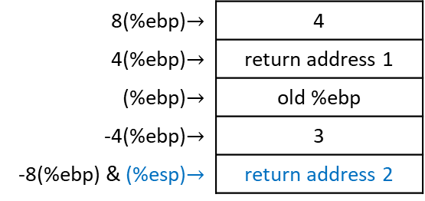
Factorial main $→$ factorial #1 $→$ factorial #2: 4$∙$3!
.type factorial, @function # tell linker this will be a function
factorial:
# Prologue
pushl %ebp # save old base pointer
movl %esp, %ebp # make stack pointer the base pointer
movl 8(%ebp), %eax # move 1st argument into %eax
cmpl $1, %eax # base case so we return
# (return value %eax already 1)
je end_factorial
decl %eax # otherwise, decrease the value
pushl %eax # push it for our call to factorial
call factorial # call the factorial function
movl 8(%ebp), %ebx # %eax has return value so reload
# our parameter into %ebx
imull %ebx, %eax # multiply that by the last result
# of factorial, answer stored in
# %eax (already return value)
end_factorial:
# Epilogue
movl %ebp, %esp # restore stack pointer
popl %ebp # restore base pointer
ret # popl %eip
8(%ebp)$→$ | 4
4(%ebp)$→$ | return address 1
(%ebp)$→$ | old %ebp
-4(%ebp)$→$ | 3
-8(%ebp) & (%esp)$→$ | return address 2
EIP = start of power function
EAX = 3

Slide 15
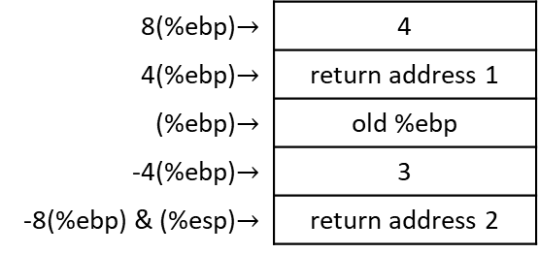
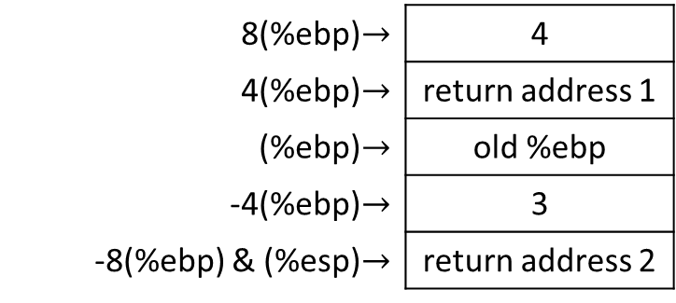
Factorial main $→$ factorial #1 $→$ factorial #2: 4$∙$3!
.type factorial, @function # tell linker this will be a function
factorial:
# Prologue
pushl %ebp # save old base pointer
movl %esp, %ebp # make stack pointer the base pointer
movl 8(%ebp), %eax # move 1st argument into %eax
cmpl $1, %eax # base case so we return
# (return value %eax already 1)
je end_factorial
decl %eax # otherwise, decrease the value
pushl %eax # push it for our call to factorial
call factorial # call the factorial function
movl 8(%ebp), %ebx # %eax has return value so reload
# our parameter into %ebx
imull %ebx, %eax # multiply that by the last result
# of factorial, answer stored in
# %eax (already return value)
end_factorial:
# Epilogue
movl %ebp, %esp # restore stack pointer
popl %ebp # restore base pointer
ret # popl %eip
8(%ebp)$→$ | 4
4(%ebp)$→$ | return address 1
(%ebp)$→$ | old %ebp
-4(%ebp)$→$ | 3
-8(%ebp) & (%esp)$→$ | return address 2
EIP = start of power function
EAX = 3

Slide 16

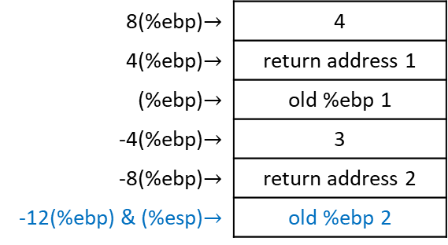
Factorial main $→$ factorial #1 $→$ factorial #2: 4$∙$3!
.type factorial, @function # tell linker this will be a function
factorial:
# Prologue
pushl %ebp # save old base pointer
movl %esp, %ebp # make stack pointer the base pointer
movl 8(%ebp), %eax # move 1st argument into %eax
cmpl $1, %eax # base case so we return
# (return value %eax already 1)
je end_factorial
decl %eax # otherwise, decrease the value
pushl %eax # push it for our call to factorial
call factorial # call the factorial function
movl 8(%ebp), %ebx # %eax has return value so reload
# our parameter into %ebx
imull %ebx, %eax # multiply that by the last result
# of factorial, answer stored in
# %eax (already return value)
end_factorial:
# Epilogue
movl %ebp, %esp # restore stack pointer
popl %ebp # restore base pointer
ret # popl %eip
8(%ebp)$→$ | 4
4(%ebp)$→$ | return address 1
(%ebp)$→$ | old %ebp 1
-4(%ebp)$→$ | 3
-8(%ebp)$→$ | return address 2
-12(%ebp) & (%esp)$→$ | old %ebp 2
EIP = start of power function
EAX = 3

Slide 17
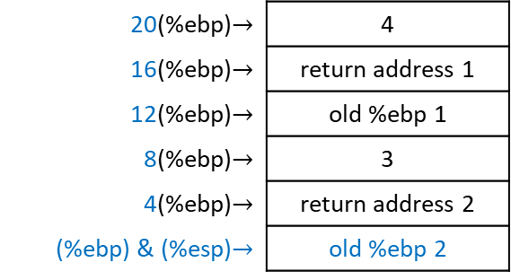
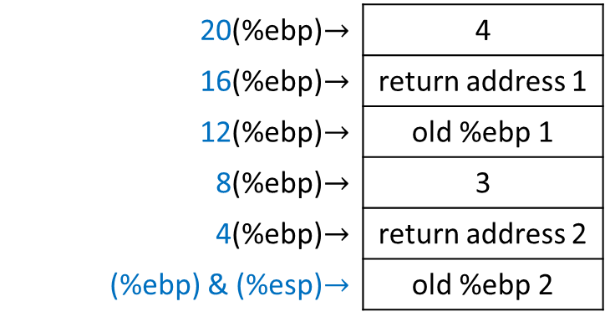
Factorial main $→$ factorial #1 $→$ factorial #2: 4$∙$3!
.type factorial, @function # tell linker this will be a function
factorial:
# Prologue
pushl %ebp # save old base pointer
movl %esp, %ebp # make stack pointer the base pointer
movl 8(%ebp), %eax # move 1st argument into %eax
cmpl $1, %eax # base case so we return
# (return value %eax already 1)
je end_factorial
decl %eax # otherwise, decrease the value
pushl %eax # push it for our call to factorial
call factorial # call the factorial function
movl 8(%ebp), %ebx # %eax has return value so reload
# our parameter into %ebx
imull %ebx, %eax # multiply that by the last result
# of factorial, answer stored in
# %eax (already return value)
end_factorial:
# Epilogue
movl %ebp, %esp # restore stack pointer
popl %ebp # restore base pointer
ret # popl %eip
20(%ebp)$→$ | 4
16(%ebp)$→$ | return address 1
12(%ebp)$→$ | old %ebp 1
8(%ebp)$→$ | 3
4(%ebp)$→$ | return address 2
(%ebp) & (%esp)$→$ | old %ebp 2
EIP = start of power function
EAX = 3

Slide 18

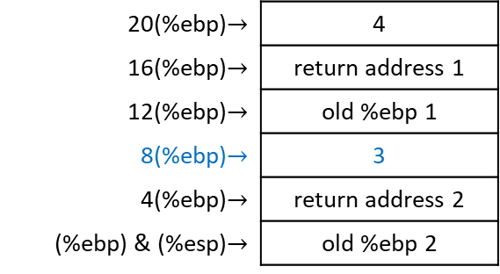
Factorial main $→$ factorial #1 $→$ factorial #2: 4$∙$3!
.type factorial, @function # tell linker this will be a function
factorial:
# Prologue
pushl %ebp # save old base pointer
movl %esp, %ebp # make stack pointer the base pointer
movl 8(%ebp), %eax # move 1st argument into %eax
cmpl $1, %eax # base case so we return
# (return value %eax already 1)
je end_factorial
decl %eax # otherwise, decrease the value
pushl %eax # push it for our call to factorial
call factorial # call the factorial function
movl 8(%ebp), %ebx # %eax has return value so reload
# our parameter into %ebx
imull %ebx, %eax # multiply that by the last result
# of factorial, answer stored in
# %eax (already return value)
end_factorial:
# Epilogue
movl %ebp, %esp # restore stack pointer
popl %ebp # restore base pointer
ret # popl %eip
20(%ebp)$→$ | 4
16(%ebp)$→$ | return address 1
12(%ebp)$→$ | old %ebp 1
8(%ebp)$→$ | 3
4(%ebp)$→$ | return address 2
(%ebp) & (%esp)$→$ | old %ebp 2
EIP = start of power function
EAX = 3

Slide 19
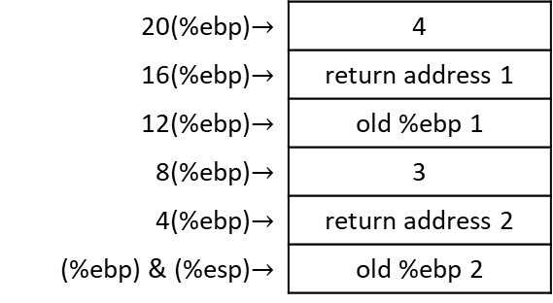


Factorial main $→$ factorial #1 $→$ factorial #2: 4$∙$3?
.type factorial, @function # tell linker this will be a function
factorial:
# Prologue
pushl %ebp # save old base pointer
movl %esp, %ebp # make stack pointer the base pointer
movl 8(%ebp), %eax # move 1st argument into %eax
cmpl $1, %eax # base case so we return
# (return value %eax already 1)
je end_factorial
decl %eax # otherwise, decrease the value
pushl %eax # push it for our call to factorial
call factorial # call the factorial function
movl 8(%ebp), %ebx # %eax has return value so reload
# our parameter into %ebx
imull %ebx, %eax # multiply that by the last result
# of factorial, answer stored in
# %eax (already return value)
end_factorial:
# Epilogue
movl %ebp, %esp # restore stack pointer
popl %ebp # restore base pointer
ret # popl %eip
20(%ebp)$→$ | 4
16(%ebp)$→$ | return address 1
12(%ebp)$→$ | old %ebp 1
8(%ebp)$→$ | 3
4(%ebp)$→$ | return address 2
(%ebp) & (%esp)$→$ | old %ebp 2
EIP = start of power function
EAX = 3 = 1 ? $→$ false

Slide 20
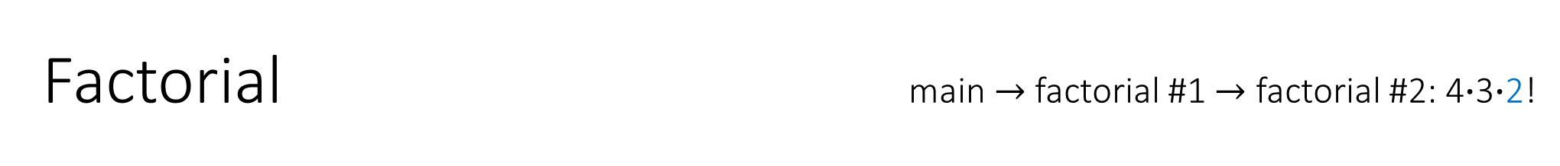
Factorial main $→$ factorial #1 $→$ factorial #2: 4$∙$3$∙$2!
.type factorial, @function # tell linker this will be a function
factorial:
# Prologue
pushl %ebp # save old base pointer
movl %esp, %ebp # make stack pointer the base pointer
movl 8(%ebp), %eax # move 1st argument into %eax
cmpl $1, %eax # base case so we return
# (return value %eax already 1)
je end_factorial
decl %eax # otherwise, decrease the value
pushl %eax # push it for our call to factorial
call factorial # call the factorial function
movl 8(%ebp), %ebx # %eax has return value so reload
# our parameter into %ebx
imull %ebx, %eax # multiply that by the last result
# of factorial, answer stored in
# %eax (already return value)
end_factorial:
# Epilogue
movl %ebp, %esp # restore stack pointer
popl %ebp # restore base pointer
ret # popl %eip
20(%ebp)$→$ | 4
16(%ebp)$→$ | return address 1
12(%ebp)$→$ | old %ebp 1
8(%ebp)$→$ | 3
4(%ebp)$→$ | return address 2
(%ebp) & (%esp)$→$ | old %ebp 2
EIP = start of power function
EAX = 2

Slide 21
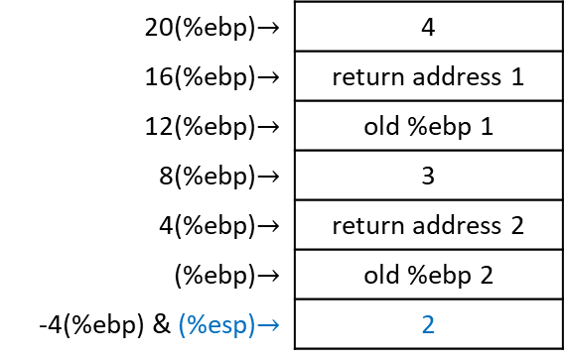
Factorial main $→$ factorial #1 $→$ factorial #2: 4$∙$3$∙$2!
.type factorial, @function # tell linker this will be a function
factorial:
# Prologue
pushl %ebp # save old base pointer
movl %esp, %ebp # make stack pointer the base pointer
movl 8(%ebp), %eax # move 1st argument into %eax
cmpl $1, %eax # base case so we return
# (return value %eax already 1)
je end_factorial
decl %eax # otherwise, decrease the value
pushl %eax # push it for our call to factorial
call factorial # call the factorial function
movl 8(%ebp), %ebx # %eax has return value so reload
# our parameter into %ebx
imull %ebx, %eax # multiply that by the last result
# of factorial, answer stored in
# %eax (already return value)
end_factorial:
# Epilogue
movl %ebp, %esp # restore stack pointer
popl %ebp # restore base pointer
ret # popl %eip
20(%ebp)$→$ | 4
16(%ebp)$→$ | return address 1
12(%ebp)$→$ | old %ebp 1
8(%ebp)$→$ | 3
4(%ebp)$→$ | return address 2
(%ebp)$→$ | old %ebp 2
-4(%ebp) & (%esp)$→$ | 2
EIP = start of power function
EAX = 2

Slide 22
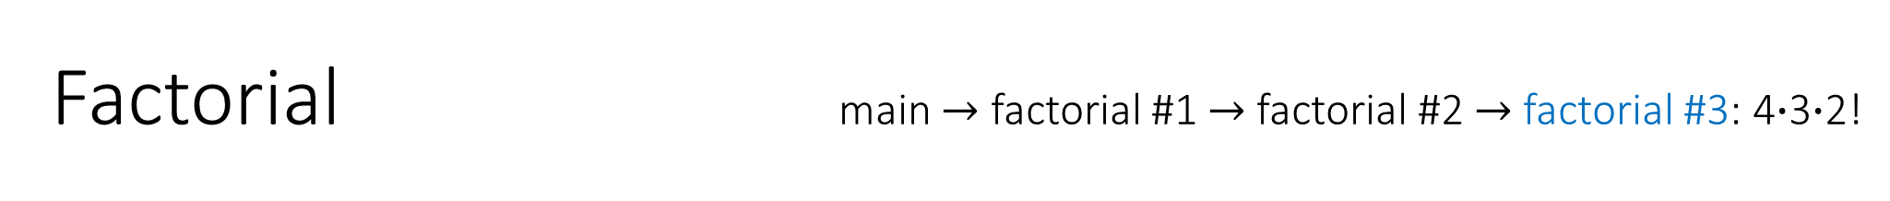
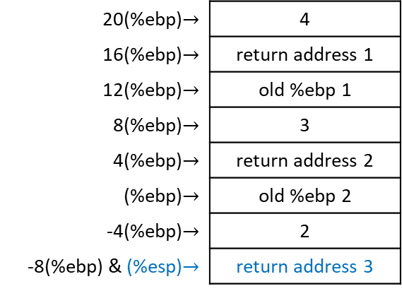
Factorial main $→$ factorial #1 $→$ factorial #2 $→$ factorial #3: 4$∙$3$∙$2!
.type factorial, @function # tell linker this will be a function
factorial:
# Prologue
pushl %ebp # save old base pointer
movl %esp, %ebp # make stack pointer the base pointer
movl 8(%ebp), %eax # move 1st argument into %eax
cmpl $1, %eax # base case so we return
# (return value %eax already 1)
je end_factorial
decl %eax # otherwise, decrease the value
pushl %eax # push it for our call to factorial
call factorial # call the factorial function
movl 8(%ebp), %ebx # %eax has return value so reload
# our parameter into %ebx
imull %ebx, %eax # multiply that by the last result
# of factorial, answer stored in
# %eax (already return value)
end_factorial:
# Epilogue
movl %ebp, %esp # restore stack pointer
popl %ebp # restore base pointer
ret # popl %eip
20(%ebp)$→$ | 4
16(%ebp)$→$ | return address 1
12(%ebp)$→$ | old %ebp 1
8(%ebp)$→$ | 3
4(%ebp)$→$ | return address 2
(%ebp)$→$ | old %ebp 2
-4(%ebp)$→$ | 2
-8(%ebp) & (%esp)$→$ | return address 3
EIP = start of power function
EAX = 2

Slide 23
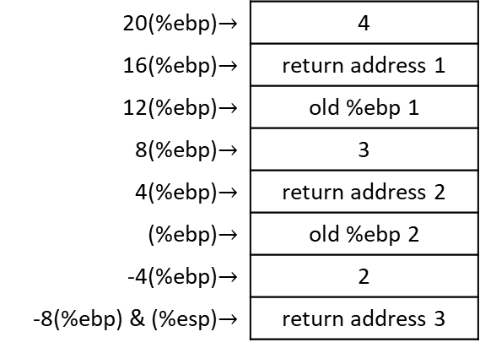
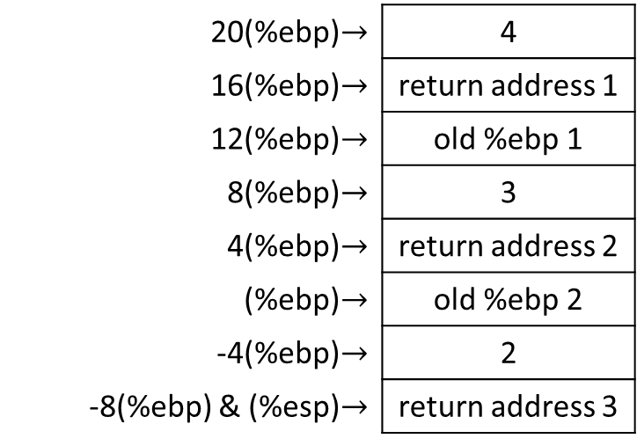
Factorial main $→$ factorial #1 $→$ factorial #2 $→$ factorial #3: 4$∙$3$∙$2!
.type factorial, @function # tell linker this will be a function
factorial:
# Prologue
pushl %ebp # save old base pointer
movl %esp, %ebp # make stack pointer the base pointer
movl 8(%ebp), %eax # move 1st argument into %eax
cmpl $1, %eax # base case so we return
# (return value %eax already 1)
je end_factorial
decl %eax # otherwise, decrease the value
pushl %eax # push it for our call to factorial
call factorial # call the factorial function
movl 8(%ebp), %ebx # %eax has return value so reload
# our parameter into %ebx
imull %ebx, %eax # multiply that by the last result
# of factorial, answer stored in
# %eax (already return value)
end_factorial:
# Epilogue
movl %ebp, %esp # restore stack pointer
popl %ebp # restore base pointer
ret # popl %eip
20(%ebp)$→$ | 4
16(%ebp)$→$ | return address 1
12(%ebp)$→$ | old %ebp 1
8(%ebp)$→$ | 3
4(%ebp)$→$ | return address 2
(%ebp)$→$ | old %ebp 2
-4(%ebp)$→$ | 2
-8(%ebp) & (%esp)$→$ | return address 3
EIP = start of power function
EAX = 2

Slide 24
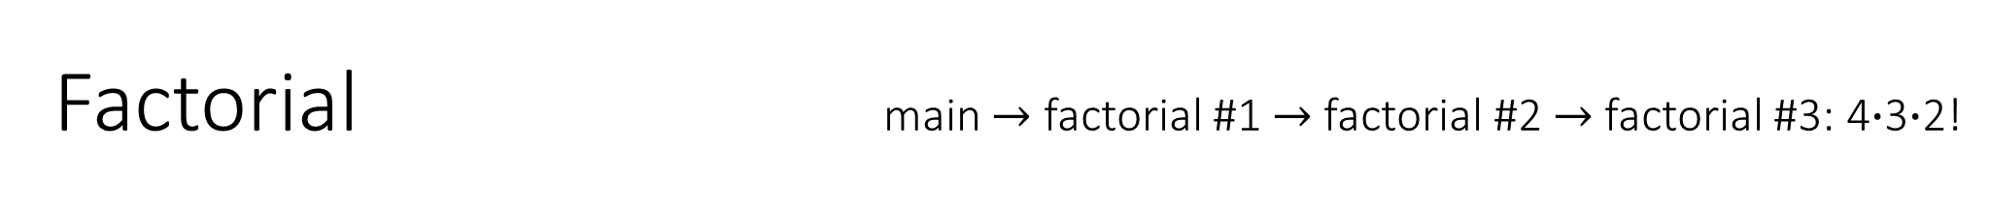
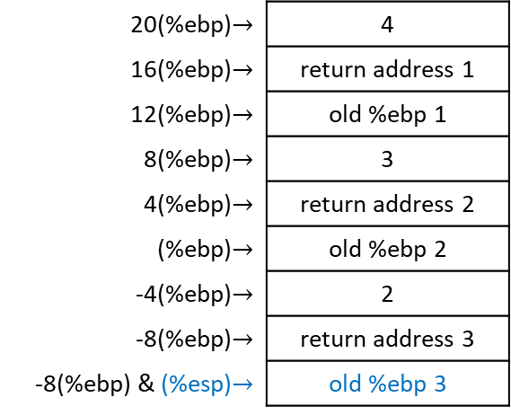
Factorial main $→$ factorial #1 $→$ factorial #2 $→$ factorial #3: 4$∙$3$∙$2!
.type factorial, @function # tell linker this will be a function
factorial:
# Prologue
pushl %ebp # save old base pointer
movl %esp, %ebp # make stack pointer the base pointer
movl 8(%ebp), %eax # move 1st argument into %eax
cmpl $1, %eax # base case so we return
# (return value %eax already 1)
je end_factorial
decl %eax # otherwise, decrease the value
pushl %eax # push it for our call to factorial
call factorial # call the factorial function
movl 8(%ebp), %ebx # %eax has return value so reload
# our parameter into %ebx
imull %ebx, %eax # multiply that by the last result
# of factorial, answer stored in
# %eax (already return value)
end_factorial:
# Epilogue
movl %ebp, %esp # restore stack pointer
popl %ebp # restore base pointer
ret # popl %eip
20(%ebp)$→$ | 4
16(%ebp)$→$ | return address 1
12(%ebp)$→$ | old %ebp 1
8(%ebp)$→$ | 3
4(%ebp)$→$ | return address 2
(%ebp)$→$ | old %ebp 2
-4(%ebp)$→$ | 2
-8(%ebp)$→$ | return address 3
-8(%ebp) & (%esp)$→$ | old %ebp 3
EIP = start of power function
EAX = 2

Slide 25
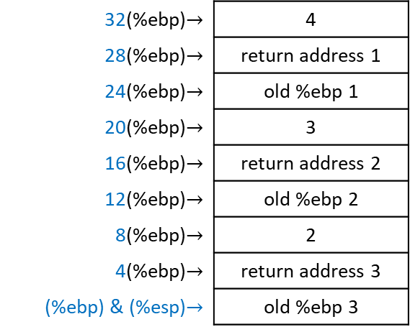
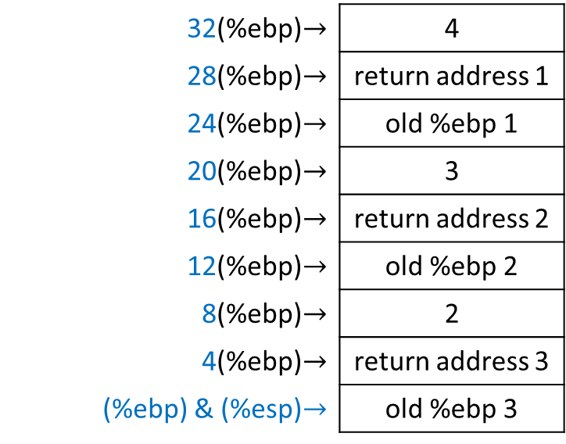
Factorial main $→$ factorial #1 $→$ factorial #2 $→$ factorial #3: 4$∙$3$∙$2!
.type factorial, @function # tell linker this will be a function
factorial:
# Prologue
pushl %ebp # save old base pointer
movl %esp, %ebp # make stack pointer the base pointer
movl 8(%ebp), %eax # move 1st argument into %eax
cmpl $1, %eax # base case so we return
# (return value %eax already 1)
je end_factorial
decl %eax # otherwise, decrease the value
pushl %eax # push it for our call to factorial
call factorial # call the factorial function
movl 8(%ebp), %ebx # %eax has return value so reload
# our parameter into %ebx
imull %ebx, %eax # multiply that by the last result
# of factorial, answer stored in
# %eax (already return value)
end_factorial:
# Epilogue
movl %ebp, %esp # restore stack pointer
popl %ebp # restore base pointer
ret # popl %eip
32(%ebp)$→$ | 4
28(%ebp)$→$ | return address 1
24(%ebp)$→$ | old %ebp 1
20(%ebp)$→$ | 3
16(%ebp)$→$ | return address 2
12(%ebp)$→$ | old %ebp 2
8(%ebp)$→$ | 2
4(%ebp)$→$ | return address 3
(%ebp) & (%esp)$→$ | old %ebp 3
EIP = start of power function
EAX = 2

Slide 26
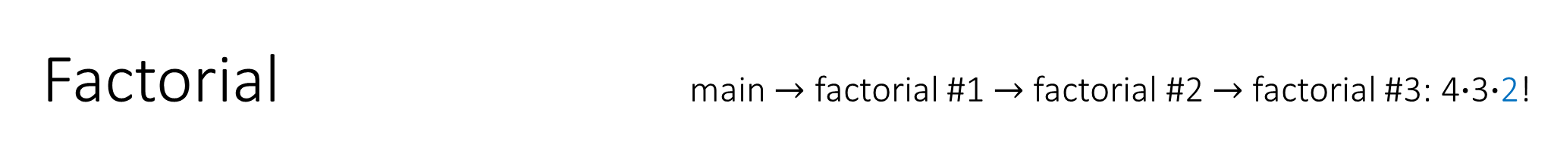
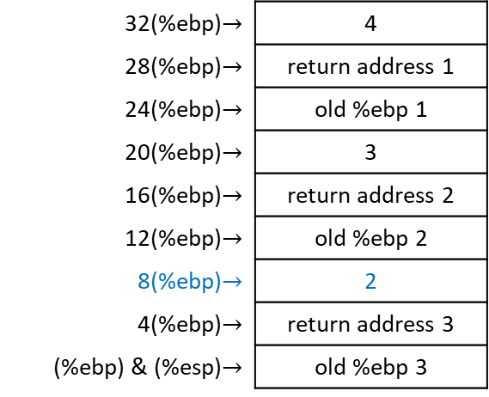
Factorial main $→$ factorial #1 $→$ factorial #2 $→$ factorial #3: 4$∙$3$∙$2!
.type factorial, @function # tell linker this will be a function
factorial:
# Prologue
pushl %ebp # save old base pointer
movl %esp, %ebp # make stack pointer the base pointer
movl 8(%ebp), %eax # move 1st argument into %eax
cmpl $1, %eax # base case so we return
# (return value %eax already 1)
je end_factorial
decl %eax # otherwise, decrease the value
pushl %eax # push it for our call to factorial
call factorial # call the factorial function
movl 8(%ebp), %ebx # %eax has return value so reload
# our parameter into %ebx
imull %ebx, %eax # multiply that by the last result
# of factorial, answer stored in
# %eax (already return value)
end_factorial:
# Epilogue
movl %ebp, %esp # restore stack pointer
popl %ebp # restore base pointer
ret # popl %eip
32(%ebp)$→$ | 4
28(%ebp)$→$ | return address 1
24(%ebp)$→$ | old %ebp 1
20(%ebp)$→$ | 3
16(%ebp)$→$ | return address 2
12(%ebp)$→$ | old %ebp 2
8(%ebp)$→$ | 2
4(%ebp)$→$ | return address 3
(%ebp) & (%esp)$→$ | old %ebp 3
EIP = start of power function
EAX = 2

Slide 27
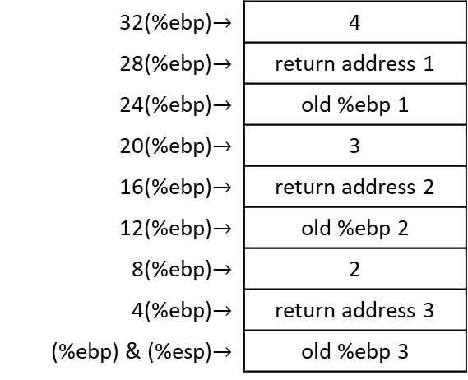


Factorial main $→$ factorial #1 $→$ factorial #2 $→$ factorial #3: 4$∙$3$∙$2?
.type factorial, @function # tell linker this will be a function
factorial:
# Prologue
pushl %ebp # save old base pointer
movl %esp, %ebp # make stack pointer the base pointer
movl 8(%ebp), %eax # move 1st argument into %eax
cmpl $1, %eax # base case so we return
# (return value %eax already 1)
je end_factorial
decl %eax # otherwise, decrease the value
pushl %eax # push it for our call to factorial
call factorial # call the factorial function
movl 8(%ebp), %ebx # %eax has return value so reload
# our parameter into %ebx
imull %ebx, %eax # multiply that by the last result
# of factorial, answer stored in
# %eax (already return value)
end_factorial:
# Epilogue
movl %ebp, %esp # restore stack pointer
popl %ebp # restore base pointer
ret # popl %eip
32(%ebp)$→$ | 4
28(%ebp)$→$ | return address 1
24(%ebp)$→$ | old %ebp 1
20(%ebp)$→$ | 3
16(%ebp)$→$ | return address 2
12(%ebp)$→$ | old %ebp 2
8(%ebp)$→$ | 2
4(%ebp)$→$ | return address 3
(%ebp) & (%esp)$→$ | old %ebp 3
EIP = start of power function
EAX = 2 = 1 ? $→$ false

Slide 28
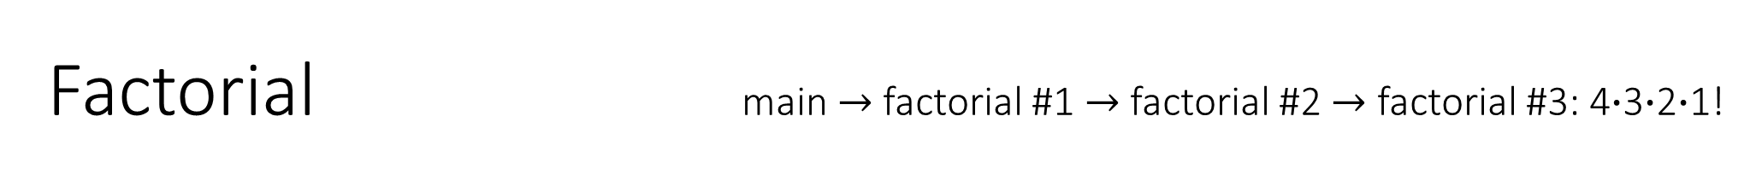
Factorial main $→$ factorial #1 $→$ factorial #2 $→$ factorial #3: 4$∙$3$∙$2$∙$1!
.type factorial, @function # tell linker this will be a function
factorial:
# Prologue
pushl %ebp # save old base pointer
movl %esp, %ebp # make stack pointer the base pointer
movl 8(%ebp), %eax # move 1st argument into %eax
cmpl $1, %eax # base case so we return
# (return value %eax already 1)
je end_factorial
decl %eax # otherwise, decrease the value
pushl %eax # push it for our call to factorial
call factorial # call the factorial function
movl 8(%ebp), %ebx # %eax has return value so reload
# our parameter into %ebx
imull %ebx, %eax # multiply that by the last result
# of factorial, answer stored in
# %eax (already return value)
end_factorial:
# Epilogue
movl %ebp, %esp # restore stack pointer
popl %ebp # restore base pointer
ret # popl %eip
32(%ebp)$→$ | 4
28(%ebp)$→$ | return address 1
24(%ebp)$→$ | old %ebp 1
20(%ebp)$→$ | 3
16(%ebp)$→$ | return address 2
12(%ebp)$→$ | old %ebp 2
8(%ebp)$→$ | 2
4(%ebp)$→$ | return address 3
(%ebp) & (%esp)$→$ | old %ebp 3
EIP = start of power function
EAX = 1

Slide 29

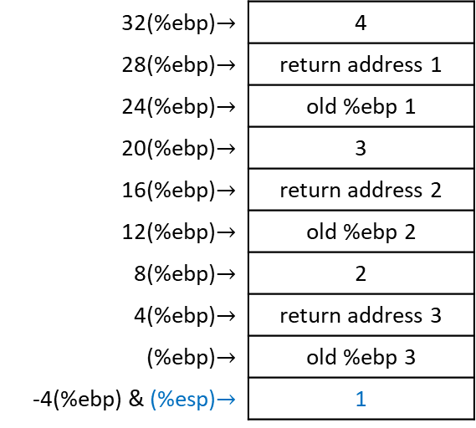
Factorial main $→$ factorial #1 $→$ factorial #2 $→$ factorial #3: 4$∙$3$∙$2$∙$1!
.type factorial, @function # tell linker this will be a function
factorial:
# Prologue
pushl %ebp # save old base pointer
movl %esp, %ebp # make stack pointer the base pointer
movl 8(%ebp), %eax # move 1st argument into %eax
cmpl $1, %eax # base case so we return
# (return value %eax already 1)
je end_factorial
decl %eax # otherwise, decrease the value
pushl %eax # push it for our call to factorial
call factorial # call the factorial function
movl 8(%ebp), %ebx # %eax has return value so reload
# our parameter into %ebx
imull %ebx, %eax # multiply that by the last result
# of factorial, answer stored in
# %eax (already return value)
end_factorial:
# Epilogue
movl %ebp, %esp # restore stack pointer
popl %ebp # restore base pointer
ret # popl %eip
32(%ebp)$→$ | 4
28(%ebp)$→$ | return address 1
24(%ebp)$→$ | old %ebp 1
20(%ebp)$→$ | 3
16(%ebp)$→$ | return address 2
12(%ebp)$→$ | old %ebp 2
8(%ebp)$→$ | 2
4(%ebp)$→$ | return address 3
(%ebp)$→$ | old %ebp 3
-4(%ebp) & (%esp)$→$ | 1
EIP = start of power function
EAX = 1

Slide 30
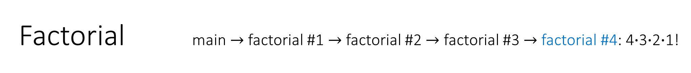
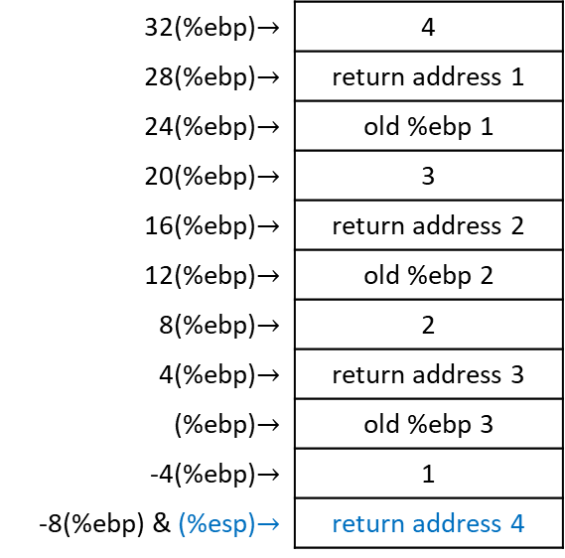
Factorial main $→$ factorial #1 $→$ factorial #2 $→$ factorial #3 $→$ factorial #4: 4$∙$3$∙$2$∙$1!
.type factorial, @function # tell linker this will be a function
factorial:
# Prologue
pushl %ebp # save old base pointer
movl %esp, %ebp # make stack pointer the base pointer
movl 8(%ebp), %eax # move 1st argument into %eax
cmpl $1, %eax # base case so we return
# (return value %eax already 1)
je end_factorial
decl %eax # otherwise, decrease the value
pushl %eax # push it for our call to factorial
call factorial # call the factorial function
movl 8(%ebp), %ebx # %eax has return value so reload
# our parameter into %ebx
imull %ebx, %eax # multiply that by the last result
# of factorial, answer stored in
# %eax (already return value)
end_factorial:
# Epilogue
movl %ebp, %esp # restore stack pointer
popl %ebp # restore base pointer
ret # popl %eip
32(%ebp)$→$ | 4
28(%ebp)$→$ | return address 1
24(%ebp)$→$ | old %ebp 1
20(%ebp)$→$ | 3
16(%ebp)$→$ | return address 2
12(%ebp)$→$ | old %ebp 2
8(%ebp)$→$ | 2
4(%ebp)$→$ | return address 3
(%ebp)$→$ | old %ebp 3
-4(%ebp)$→$ | 1
-8(%ebp) & (%esp)$→$ | return address 4
EIP = start of power function
EAX = 1

Slide 31
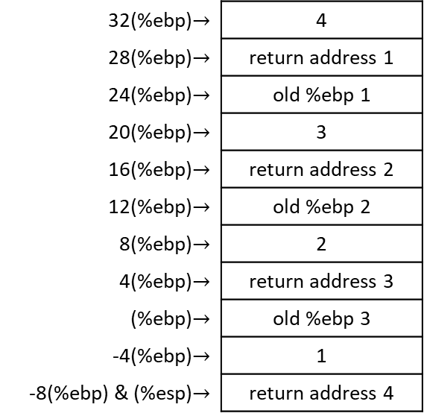
Factorial main $→$ factorial #1 $→$ factorial #2 $→$ factorial #3 $→$ factorial #4: 4$∙$3$∙$2$∙$1!
.type factorial, @function # tell linker this will be a function
factorial:
# Prologue
pushl %ebp # save old base pointer
movl %esp, %ebp # make stack pointer the base pointer
movl 8(%ebp), %eax # move 1st argument into %eax
cmpl $1, %eax # base case so we return
# (return value %eax already 1)
je end_factorial
decl %eax # otherwise, decrease the value
pushl %eax # push it for our call to factorial
call factorial # call the factorial function
movl 8(%ebp), %ebx # %eax has return value so reload
# our parameter into %ebx
imull %ebx, %eax # multiply that by the last result
# of factorial, answer stored in
# %eax (already return value)
end_factorial:
# Epilogue
movl %ebp, %esp # restore stack pointer
popl %ebp # restore base pointer
ret # popl %eip
32(%ebp)$→$ | 4
28(%ebp)$→$ | return address 1
24(%ebp)$→$ | old %ebp 1
20(%ebp)$→$ | 3
16(%ebp)$→$ | return address 2
12(%ebp)$→$ | old %ebp 2
8(%ebp)$→$ | 2
4(%ebp)$→$ | return address 3
(%ebp)$→$ | old %ebp 3
-4(%ebp)$→$ | 1
-8(%ebp) & (%esp)$→$ | return address 4
EIP = start of power function
EAX = 1

Slide 32
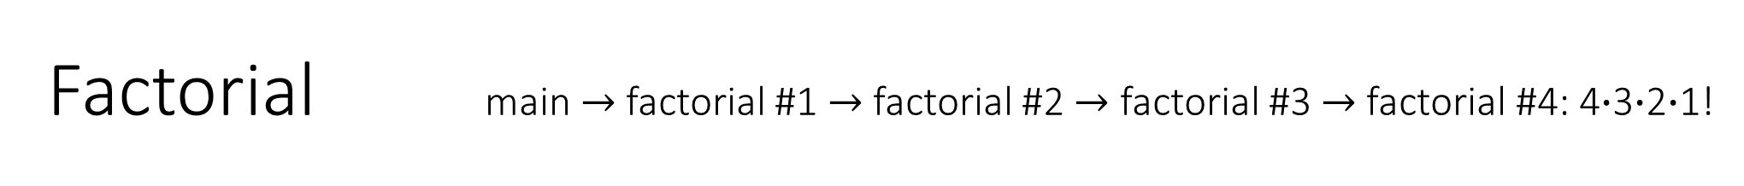
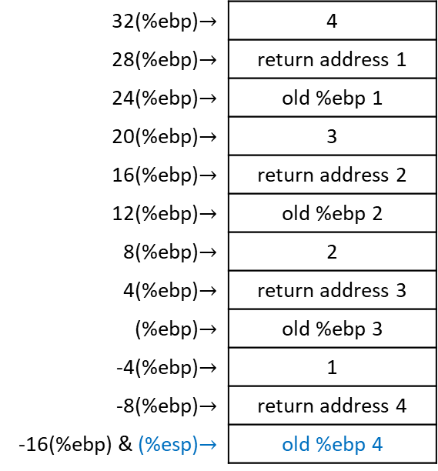
Factorial main $→$ factorial #1 $→$ factorial #2 $→$ factorial #3 $→$ factorial #4: 4$∙$3$∙$2$∙$1!
.type factorial, @function # tell linker this will be a function
factorial:
# Prologue
pushl %ebp # save old base pointer
movl %esp, %ebp # make stack pointer the base pointer
movl 8(%ebp), %eax # move 1st argument into %eax
cmpl $1, %eax # base case so we return
# (return value %eax already 1)
je end_factorial
decl %eax # otherwise, decrease the value
pushl %eax # push it for our call to factorial
call factorial # call the factorial function
movl 8(%ebp), %ebx # %eax has return value so reload
# our parameter into %ebx
imull %ebx, %eax # multiply that by the last result
# of factorial, answer stored in
# %eax (already return value)
end_factorial:
# Epilogue
movl %ebp, %esp # restore stack pointer
popl %ebp # restore base pointer
ret # popl %eip
32(%ebp)$→$ | 4
28(%ebp)$→$ | return address 1
24(%ebp)$→$ | old %ebp 1
20(%ebp)$→$ | 3
16(%ebp)$→$ | return address 2
12(%ebp)$→$ | old %ebp 2
8(%ebp)$→$ | 2
4(%ebp)$→$ | return address 3
(%ebp)$→$ | old %ebp 3
-4(%ebp)$→$ | 1
-8(%ebp)$→$ | return address 4
-16(%ebp) & (%esp)$→$ | old %ebp 4
EIP = start of power function
EAX = 1

Slide 33
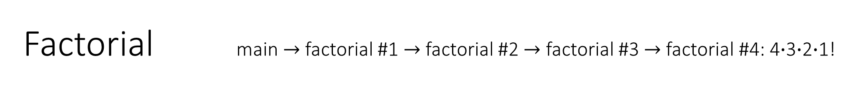
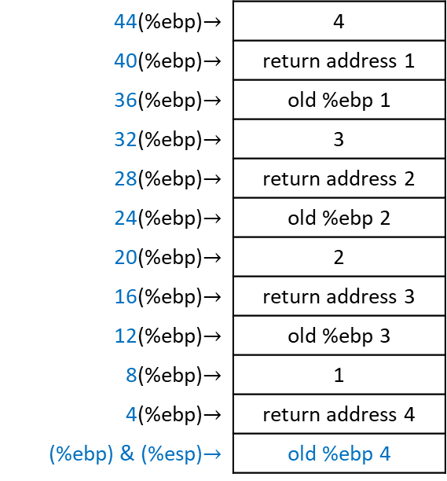
Factorial main $→$ factorial #1 $→$ factorial #2 $→$ factorial #3 $→$ factorial #4: 4$∙$3$∙$2$∙$1!
.type factorial, @function # tell linker this will be a function
factorial:
# Prologue
pushl %ebp # save old base pointer
movl %esp, %ebp # make stack pointer the base pointer
movl 8(%ebp), %eax # move 1st argument into %eax
cmpl $1, %eax # base case so we return
# (return value %eax already 1)
je end_factorial
decl %eax # otherwise, decrease the value
pushl %eax # push it for our call to factorial
call factorial # call the factorial function
movl 8(%ebp), %ebx # %eax has return value so reload
# our parameter into %ebx
imull %ebx, %eax # multiply that by the last result
# of factorial, answer stored in
# %eax (already return value)
end_factorial:
# Epilogue
movl %ebp, %esp # restore stack pointer
popl %ebp # restore base pointer
ret # popl %eip
44(%ebp)$→$ | 4
40(%ebp)$→$ | return address 1
36(%ebp)$→$ | old %ebp 1
32(%ebp)$→$ | 3
28(%ebp)$→$ | return address 2
24(%ebp)$→$ | old %ebp 2
20(%ebp)$→$ | 2
16(%ebp)$→$ | return address 3
12(%ebp)$→$ | old %ebp 3
8(%ebp)$→$ | 1
4(%ebp)$→$ | return address 4
(%ebp) & (%esp)$→$ | old %ebp 4
EIP = start of power function
EAX = 1

Slide 34
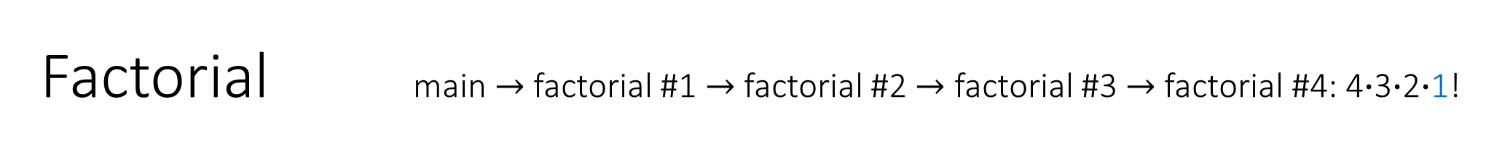
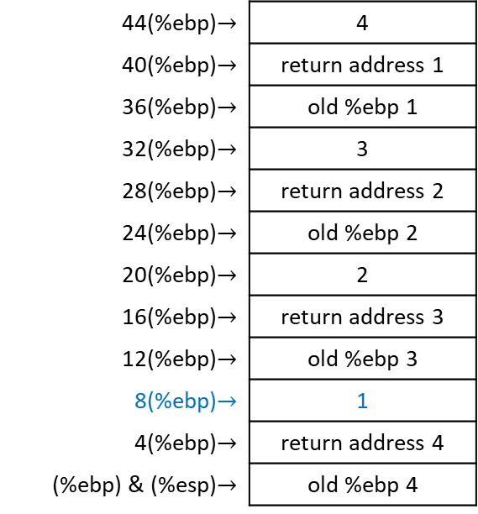
Factorial main $→$ factorial #1 $→$ factorial #2 $→$ factorial #3 $→$ factorial #4: 4$∙$3$∙$2$∙$1!
.type factorial, @function # tell linker this will be a function
factorial:
# Prologue
pushl %ebp # save old base pointer
movl %esp, %ebp # make stack pointer the base pointer
movl 8(%ebp), %eax # move 1st argument into %eax
cmpl $1, %eax # base case so we return
# (return value %eax already 1)
je end_factorial
decl %eax # otherwise, decrease the value
pushl %eax # push it for our call to factorial
call factorial # call the factorial function
movl 8(%ebp), %ebx # %eax has return value so reload
# our parameter into %ebx
imull %ebx, %eax # multiply that by the last result
# of factorial, answer stored in
# %eax (already return value)
end_factorial:
# Epilogue
movl %ebp, %esp # restore stack pointer
popl %ebp # restore base pointer
ret # popl %eip
44(%ebp)$→$ | 4
40(%ebp)$→$ | return address 1
36(%ebp)$→$ | old %ebp 1
32(%ebp)$→$ | 3
28(%ebp)$→$ | return address 2
24(%ebp)$→$ | old %ebp 2
20(%ebp)$→$ | 2
16(%ebp)$→$ | return address 3
12(%ebp)$→$ | old %ebp 3
8(%ebp)$→$ | 1
4(%ebp)$→$ | return address 4
(%ebp) & (%esp)$→$ | old %ebp 4
EIP = start of power function
EAX = 1

Slide 35
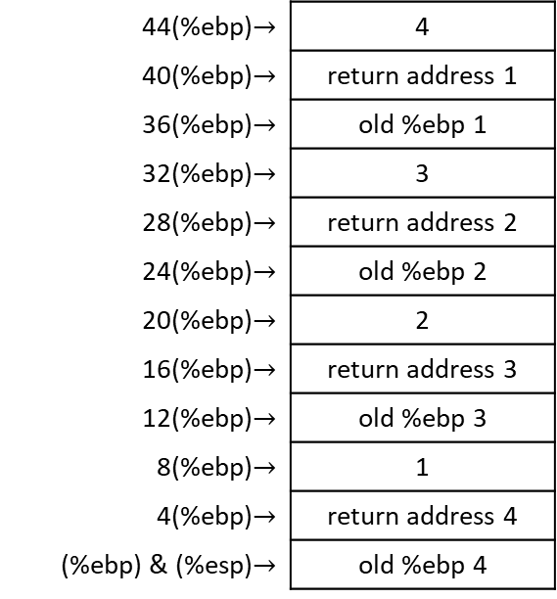


Factorial main $→$ factorial #1 $→$ factorial #2 $→$ factorial #3 $→$ factorial #4: 4$∙$3$∙$2$∙$1?
.type factorial, @function # tell linker this will be a function
factorial:
# Prologue
pushl %ebp # save old base pointer
movl %esp, %ebp # make stack pointer the base pointer
movl 8(%ebp), %eax # move 1st argument into %eax
cmpl $1, %eax # base case so we return
# (return value %eax already 1)
je end_factorial
decl %eax # otherwise, decrease the value
pushl %eax # push it for our call to factorial
call factorial # call the factorial function
movl 8(%ebp), %ebx # %eax has return value so reload
# our parameter into %ebx
imull %ebx, %eax # multiply that by the last result
# of factorial, answer stored in
# %eax (already return value)
end_factorial:
# Epilogue
movl %ebp, %esp # restore stack pointer
popl %ebp # restore base pointer
ret # popl %eip
44(%ebp)$→$ | 4
40(%ebp)$→$ | return address 1
36(%ebp)$→$ | old %ebp 1
32(%ebp)$→$ | 3
28(%ebp)$→$ | return address 2
24(%ebp)$→$ | old %ebp 2
20(%ebp)$→$ | 2
16(%ebp)$→$ | return address 3
12(%ebp)$→$ | old %ebp 3
8(%ebp)$→$ | 1
4(%ebp)$→$ | return address 4
(%ebp) & (%esp)$→$ | old %ebp 4
EIP = start of power function
EAX = 1 = 1 ? $→$ true

Slide 36
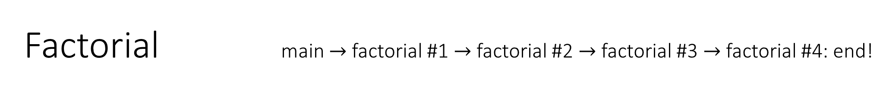
Factorial main $→$ factorial #1 $→$ factorial #2 $→$ factorial #3 $→$ factorial #4: end!
.type factorial, @function # tell linker this will be a function
factorial:
# Prologue
pushl %ebp # save old base pointer
movl %esp, %ebp # make stack pointer the base pointer
movl 8(%ebp), %eax # move 1st argument into %eax
cmpl $1, %eax # base case so we return
# (return value %eax already 1)
je end_factorial
decl %eax # otherwise, decrease the value
pushl %eax # push it for our call to factorial
call factorial # call the factorial function
movl 8(%ebp), %ebx # %eax has return value so reload
# our parameter into %ebx
imull %ebx, %eax # multiply that by the last result
# of factorial, answer stored in
# %eax (already return value)
end_factorial:
# Epilogue
movl %ebp, %esp # restore stack pointer
popl %ebp # restore base pointer
ret # popl %eip
44(%ebp)$→$ | 4
40(%ebp)$→$ | return address 1
36(%ebp)$→$ | old %ebp 1
32(%ebp)$→$ | 3
28(%ebp)$→$ | return address 2
24(%ebp)$→$ | old %ebp 2
20(%ebp)$→$ | 2
16(%ebp)$→$ | return address 3
12(%ebp)$→$ | old %ebp 3
8(%ebp)$→$ | 1
4(%ebp)$→$ | return address 4
(%ebp) & (%esp)$→$ | old %ebp 4
EIP = start of power function
EAX = 1

Slide 37

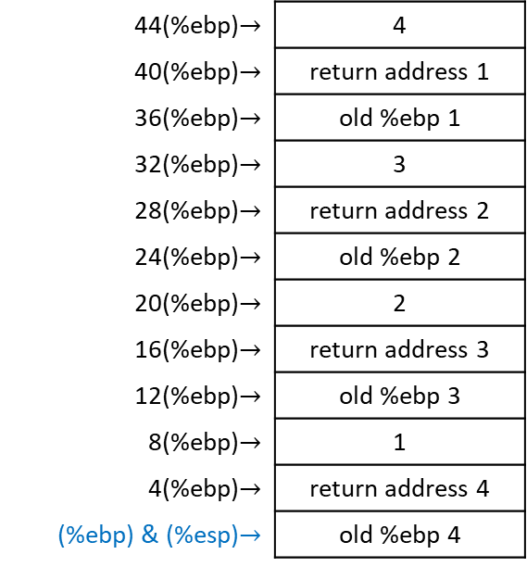
Factorial main $→$ factorial #1 $→$ factorial #2 $→$ factorial #3 $→$ factorial #4: 4$∙$3$∙$2$∙$1
.type factorial, @function # tell linker this will be a function
factorial:
# Prologue
pushl %ebp # save old base pointer
movl %esp, %ebp # make stack pointer the base pointer
movl 8(%ebp), %eax # move 1st argument into %eax
cmpl $1, %eax # base case so we return
# (return value %eax already 1)
je end_factorial
decl %eax # otherwise, decrease the value
pushl %eax # push it for our call to factorial
call factorial # call the factorial function
movl 8(%ebp), %ebx # %eax has return value so reload
# our parameter into %ebx
imull %ebx, %eax # multiply that by the last result
# of factorial, answer stored in
# %eax (already return value)
end_factorial:
# Epilogue
movl %ebp, %esp # restore stack pointer
popl %ebp # restore base pointer
ret # popl %eip
44(%ebp)$→$ | 4
40(%ebp)$→$ | return address 1
36(%ebp)$→$ | old %ebp 1
32(%ebp)$→$ | 3
28(%ebp)$→$ | return address 2
24(%ebp)$→$ | old %ebp 2
20(%ebp)$→$ | 2
16(%ebp)$→$ | return address 3
12(%ebp)$→$ | old %ebp 3
8(%ebp)$→$ | 1
4(%ebp)$→$ | return address 4
(%ebp) & (%esp)$→$ | old %ebp 4
EIP = start of power function
EAX = 1

Slide 38
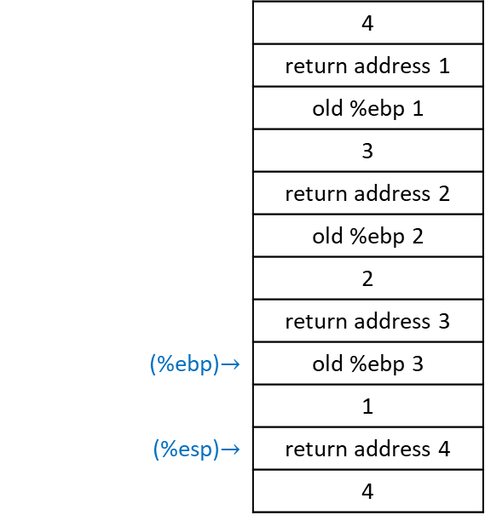
Factorial main $→$ factorial #1 $→$ factorial #2 $→$ factorial #3 $→$ factorial #4: 4$∙$3$∙$2$∙$1
.type factorial, @function # tell linker this will be a function
factorial:
# Prologue
pushl %ebp # save old base pointer
movl %esp, %ebp # make stack pointer the base pointer
movl 8(%ebp), %eax # move 1st argument into %eax
cmpl $1, %eax # base case so we return
# (return value %eax already 1)
je end_factorial
decl %eax # otherwise, decrease the value
pushl %eax # push it for our call to factorial
call factorial # call the factorial function
movl 8(%ebp), %ebx # %eax has return value so reload
# our parameter into %ebx
imull %ebx, %eax # multiply that by the last result
# of factorial, answer stored in
# %eax (already return value)
end_factorial:
# Epilogue
movl %ebp, %esp # restore stack pointer
popl %ebp # restore base pointer
ret # popl %eip
 | 4
 | return address 1
 | old %ebp 1
 | 3
 | return address 2
 | old %ebp 2
 | 2
 | return address 3
(%ebp)$→$ | old %ebp 3
 | 1
(%esp)$→$ | return address 4
 | 4
EIP = start of power function
EAX = 1
EBP = old EBP 4

Slide 39
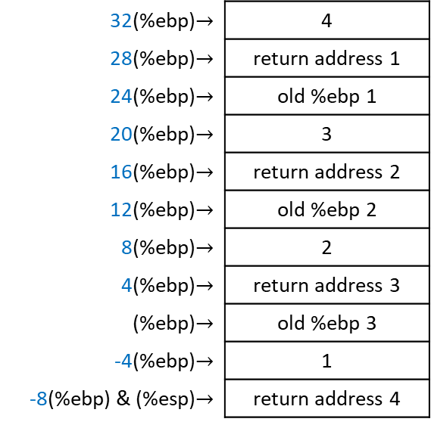
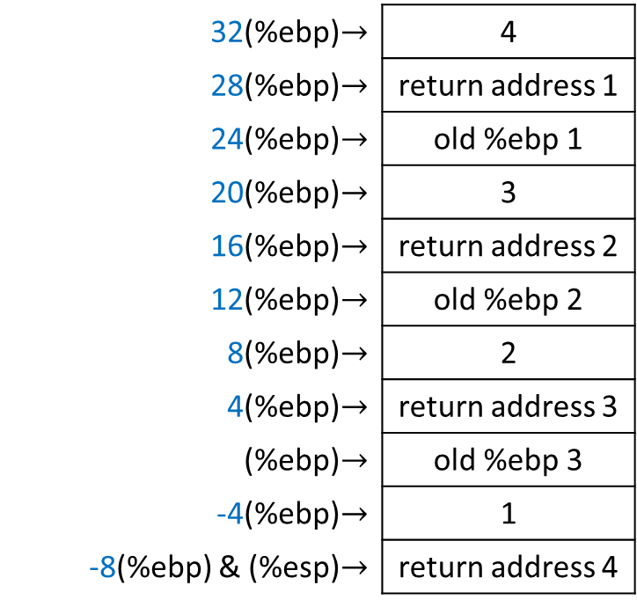
Factorial main $→$ factorial #1 $→$ factorial #2 $→$ factorial #3 $→$ factorial #4: 4$∙$3$∙$2$∙$1
.type factorial, @function # tell linker this will be a function
factorial:
# Prologue
pushl %ebp # save old base pointer
movl %esp, %ebp # make stack pointer the base pointer
movl 8(%ebp), %eax # move 1st argument into %eax
cmpl $1, %eax # base case so we return
# (return value %eax already 1)
je end_factorial
decl %eax # otherwise, decrease the value
pushl %eax # push it for our call to factorial
call factorial # call the factorial function
movl 8(%ebp), %ebx # %eax has return value so reload
# our parameter into %ebx
imull %ebx, %eax # multiply that by the last result
# of factorial, answer stored in
# %eax (already return value)
end_factorial:
# Epilogue
movl %ebp, %esp # restore stack pointer
popl %ebp # restore base pointer
ret # popl %eip
32(%ebp)$→$ | 4
28(%ebp)$→$ | return address 1
24(%ebp)$→$ | old %ebp 1
20(%ebp)$→$ | 3
16(%ebp)$→$ | return address 2
12(%ebp)$→$ | old %ebp 2
8(%ebp)$→$ | 2
4(%ebp)$→$ | return address 3
(%ebp)$→$ | old %ebp 3
-4(%ebp)$→$ | 1
-8(%ebp) & (%esp)$→$ | return address 4
EIP = start of power function
EAX = 1
EBP = old EBP 4

Slide 40

Factorial main $→$ factorial #1 $→$ factorial #2 $→$ factorial #3 $→$ factorial #4: 4$∙$3$∙$2$∙$1
.type factorial, @function # tell linker this will be a function
factorial:
# Prologue
pushl %ebp # save old base pointer
movl %esp, %ebp # make stack pointer the base pointer
movl 8(%ebp), %eax # move 1st argument into %eax
cmpl $1, %eax # base case so we return
# (return value %eax already 1)
je end_factorial
decl %eax # otherwise, decrease the value
pushl %eax # push it for our call to factorial
call factorial # call the factorial function
movl 8(%ebp), %ebx # %eax has return value so reload
# our parameter into %ebx
imull %ebx, %eax # multiply that by the last result
# of factorial, answer stored in
# %eax (already return value)
end_factorial:
# Epilogue
movl %ebp, %esp # restore stack pointer
popl %ebp # restore base pointer
ret # popl %eip
32(%ebp)$→$ | 4
28(%ebp)$→$ | return address 1
24(%ebp)$→$ | old %ebp 1
20(%ebp)$→$ | 3
16(%ebp)$→$ | return address 2
12(%ebp)$→$ | old %ebp 2
8(%ebp)$→$ | 2
4(%ebp)$→$ | return address 3
(%ebp)$→$ | old %ebp 3
-4(%ebp) & (%esp)$→$ | 1
EIP = return address 4
EAX = 1
EBP = old EBP 4

Slide 41
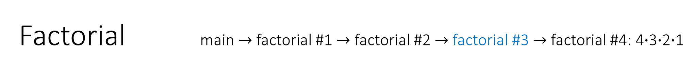
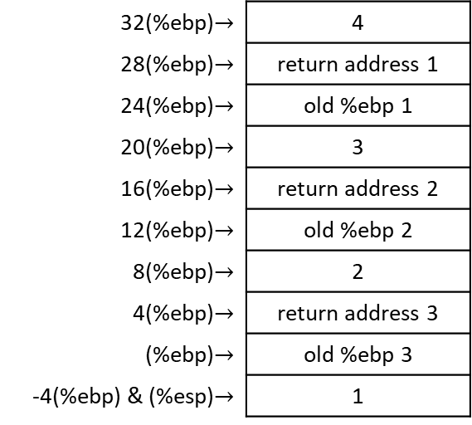
Factorial main $→$ factorial #1 $→$ factorial #2 $→$ factorial #3 $→$ factorial #4: 4$∙$3$∙$2$∙$1
.type factorial, @function # tell linker this will be a function
factorial:
# Prologue
pushl %ebp # save old base pointer
movl %esp, %ebp # make stack pointer the base pointer
movl 8(%ebp), %eax # move 1st argument into %eax
cmpl $1, %eax # base case so we return
# (return value %eax already 1)
je end_factorial
decl %eax # otherwise, decrease the value
pushl %eax # push it for our call to factorial
call factorial # call the factorial function
movl 8(%ebp), %ebx # %eax has return value so reload
# our parameter into %ebx
imull %ebx, %eax # multiply that by the last result
# of factorial, answer stored in
# %eax (already return value)
end_factorial:
# Epilogue
movl %ebp, %esp # restore stack pointer
popl %ebp # restore base pointer
ret # popl %eip
32(%ebp)$→$ | 4
28(%ebp)$→$ | return address 1
24(%ebp)$→$ | old %ebp 1
20(%ebp)$→$ | 3
16(%ebp)$→$ | return address 2
12(%ebp)$→$ | old %ebp 2
8(%ebp)$→$ | 2
4(%ebp)$→$ | return address 3
(%ebp)$→$ | old %ebp 3
-4(%ebp) & (%esp)$→$ | 1
EIP = return address 4
EAX = 1
EBP = old EBP 4

Slide 42


Factorial main $→$ factorial #1 $→$ factorial #2 $→$ factorial #3: 4$∙$3$∙$2$∙$1
.type factorial, @function # tell linker this will be a function
factorial:
# Prologue
pushl %ebp # save old base pointer
movl %esp, %ebp # make stack pointer the base pointer
movl 8(%ebp), %eax # move 1st argument into %eax
cmpl $1, %eax # base case so we return
# (return value %eax already 1)
je end_factorial
decl %eax # otherwise, decrease the value
pushl %eax # push it for our call to factorial
call factorial # call the factorial function
movl 8(%ebp), %ebx # %eax has return value so reload
# our parameter into %ebx
imull %ebx, %eax # multiply that by the last result
# of factorial, answer stored in
# %eax (already return value)
end_factorial:
# Epilogue
movl %ebp, %esp # restore stack pointer
popl %ebp # restore base pointer
ret # popl %eip
32(%ebp)$→$ | 4
28(%ebp)$→$ | return address 1
24(%ebp)$→$ | old %ebp 1
20(%ebp)$→$ | 3
16(%ebp)$→$ | return address 2
12(%ebp)$→$ | old %ebp 2
8(%ebp)$→$ | 2
4(%ebp)$→$ | return address 3
(%ebp)$→$ | old %ebp 3
-4(%ebp) & (%esp)$→$ | 1
EIP = return address 4
EAX = 1
EBP = old EBP 4
EBX = 2

Slide 43


Factorial main $→$ factorial #1 $→$ factorial #2 $→$ factorial #3: 4$∙$3$∙$2$∙$1
.type factorial, @function # tell linker this will be a function
factorial:
# Prologue
pushl %ebp # save old base pointer
movl %esp, %ebp # make stack pointer the base pointer
movl 8(%ebp), %eax # move 1st argument into %eax
cmpl $1, %eax # base case so we return
# (return value %eax already 1)
je end_factorial
decl %eax # otherwise, decrease the value
pushl %eax # push it for our call to factorial
call factorial # call the factorial function
movl 8(%ebp), %ebx # %eax has return value so reload
# our parameter into %ebx
imull %ebx, %eax # multiply that by the last result
# of factorial, answer stored in
# %eax (already return value)
end_factorial:
# Epilogue
movl %ebp, %esp # restore stack pointer
popl %ebp # restore base pointer
ret # popl %eip
32(%ebp)$→$ | 4
28(%ebp)$→$ | return address 1
24(%ebp)$→$ | old %ebp 1
20(%ebp)$→$ | 3
16(%ebp)$→$ | return address 2
12(%ebp)$→$ | old %ebp 2
8(%ebp)$→$ | 2
4(%ebp)$→$ | return address 3
(%ebp)$→$ | old %ebp 3
-4(%ebp) & (%esp)$→$ | 1
EIP = return address 4
EAX = 1 $→$ EAX = 2*1 = 2
EBP = old EBP 4
EBX = 2

Slide 44


Factorial main $→$ factorial #1 $→$ factorial #2 $→$ factorial #3: 4$∙$3$∙$2
.type factorial, @function # tell linker this will be a function
factorial:
# Prologue
pushl %ebp # save old base pointer
movl %esp, %ebp # make stack pointer the base pointer
movl 8(%ebp), %eax # move 1st argument into %eax
cmpl $1, %eax # base case so we return
# (return value %eax already 1)
je end_factorial
decl %eax # otherwise, decrease the value
pushl %eax # push it for our call to factorial
call factorial # call the factorial function
movl 8(%ebp), %ebx # %eax has return value so reload
# our parameter into %ebx
imull %ebx, %eax # multiply that by the last result
# of factorial, answer stored in
# %eax (already return value)
end_factorial:
# Epilogue
movl %ebp, %esp # restore stack pointer
popl %ebp # restore base pointer
ret # popl %eip
32(%ebp)$→$ | 4
28(%ebp)$→$ | return address 1
24(%ebp)$→$ | old %ebp 1
20(%ebp)$→$ | 3
16(%ebp)$→$ | return address 2
12(%ebp)$→$ | old %ebp 2
8(%ebp)$→$ | 2
4(%ebp)$→$ | return address 3
(%ebp) & (%esp)$→$ | old %ebp 3
EIP = return address 4
EAX = 2
EBP = old EBP 4
EBX = 2

Slide 45


Factorial main $→$ factorial #1 $→$ factorial #2 $→$ factorial #3: 4$∙$3$∙$2
.type factorial, @function # tell linker this will be a function
factorial:
# Prologue
pushl %ebp # save old base pointer
movl %esp, %ebp # make stack pointer the base pointer
movl 8(%ebp), %eax # move 1st argument into %eax
cmpl $1, %eax # base case so we return
# (return value %eax already 1)
je end_factorial
decl %eax # otherwise, decrease the value
pushl %eax # push it for our call to factorial
call factorial # call the factorial function
movl 8(%ebp), %ebx # %eax has return value so reload
# our parameter into %ebx
imull %ebx, %eax # multiply that by the last result
# of factorial, answer stored in
# %eax (already return value)
end_factorial:
# Epilogue
movl %ebp, %esp # restore stack pointer
popl %ebp # restore base pointer
ret # popl %eip
 | 4
 | return address 1
 | old %ebp 1
 | 3
 | return address 2
(%ebp)$→$ | old %ebp 2
 | 2
(%esp)$→$ | return address 3
EIP = return address 4
EAX = 2
EBP = old EBP 3
EBX = 2

Slide 46

Factorial main $→$ factorial #1 $→$ factorial #2 $→$ factorial #3: 4$∙$3$∙$2
.type factorial, @function # tell linker this will be a function
factorial:
# Prologue
pushl %ebp # save old base pointer
movl %esp, %ebp # make stack pointer the base pointer
movl 8(%ebp), %eax # move 1st argument into %eax
cmpl $1, %eax # base case so we return
# (return value %eax already 1)
je end_factorial
decl %eax # otherwise, decrease the value
pushl %eax # push it for our call to factorial
call factorial # call the factorial function
movl 8(%ebp), %ebx # %eax has return value so reload
# our parameter into %ebx
imull %ebx, %eax # multiply that by the last result
# of factorial, answer stored in
# %eax (already return value)
end_factorial:
# Epilogue
movl %ebp, %esp # restore stack pointer
popl %ebp # restore base pointer
ret # popl %eip
20(%ebp)$→$ | 4
16(%ebp)$→$ | return address 1
12(%ebp)$→$ | old %ebp 1
8(%ebp)$→$ | 3
4(%ebp)$→$ | return address 2
(%ebp)$→$ | old %ebp 2
-4(%ebp)$→$ | 2
-8(%ebp) & (%esp)$→$ | return address 3
EIP = return address 4
EAX = 2
EBP = old EBP 3
EBX = 2

Slide 47

Factorial main $→$ factorial #1 $→$ factorial #2 $→$ factorial #3: 4$∙$3$∙$2
.type factorial, @function # tell linker this will be a function
factorial:
# Prologue
pushl %ebp # save old base pointer
movl %esp, %ebp # make stack pointer the base pointer
movl 8(%ebp), %eax # move 1st argument into %eax
cmpl $1, %eax # base case so we return
# (return value %eax already 1)
je end_factorial
decl %eax # otherwise, decrease the value
pushl %eax # push it for our call to factorial
call factorial # call the factorial function
movl 8(%ebp), %ebx # %eax has return value so reload
# our parameter into %ebx
imull %ebx, %eax # multiply that by the last result
# of factorial, answer stored in
# %eax (already return value)
end_factorial:
# Epilogue
movl %ebp, %esp # restore stack pointer
popl %ebp # restore base pointer
ret # popl %eip
20(%ebp)$→$ | 4
16(%ebp)$→$ | return address 1
12(%ebp)$→$ | old %ebp 1
8(%ebp)$→$ | 3
4(%ebp)$→$ | return address 2
(%ebp)$→$ | old %ebp 2
-4(%ebp) & (%esp)$→$ | 2
EIP = return address 3
EAX = 2
EBP = old EBP 3
EBX = 2

Slide 48


Factorial main $→$ factorial #1 $→$ factorial #2 $→$ factorial #3: 4$∙$3$∙$2
.type factorial, @function # tell linker this will be a function
factorial:
# Prologue
pushl %ebp # save old base pointer
movl %esp, %ebp # make stack pointer the base pointer
movl 8(%ebp), %eax # move 1st argument into %eax
cmpl $1, %eax # base case so we return
# (return value %eax already 1)
je end_factorial
decl %eax # otherwise, decrease the value
pushl %eax # push it for our call to factorial
call factorial # call the factorial function
movl 8(%ebp), %ebx # %eax has return value so reload
# our parameter into %ebx
imull %ebx, %eax # multiply that by the last result
# of factorial, answer stored in
# %eax (already return value)
end_factorial:
# Epilogue
movl %ebp, %esp # restore stack pointer
popl %ebp # restore base pointer
ret # popl %eip
20(%ebp)$→$ | 4
16(%ebp)$→$ | return address 1
12(%ebp)$→$ | old %ebp 1
8(%ebp)$→$ | 3
4(%ebp)$→$ | return address 2
(%ebp)$→$ | old %ebp 2
-4(%ebp) & (%esp)$→$ | 2
EIP = return address 3
EAX = 2
EBP = old EBP 3
EBX = 2

Slide 49


Factorial main $→$ factorial #1 $→$ factorial #2: 4$∙$3$∙$2
.type factorial, @function # tell linker this will be a function
factorial:
# Prologue
pushl %ebp # save old base pointer
movl %esp, %ebp # make stack pointer the base pointer
movl 8(%ebp), %eax # move 1st argument into %eax
cmpl $1, %eax # base case so we return
# (return value %eax already 1)
je end_factorial
decl %eax # otherwise, decrease the value
pushl %eax # push it for our call to factorial
call factorial # call the factorial function
movl 8(%ebp), %ebx # %eax has return value so reload
# our parameter into %ebx
imull %ebx, %eax # multiply that by the last result
# of factorial, answer stored in
# %eax (already return value)
end_factorial:
# Epilogue
movl %ebp, %esp # restore stack pointer
popl %ebp # restore base pointer
ret # popl %eip
20(%ebp)$→$ | 4
16(%ebp)$→$ | return address 1
12(%ebp)$→$ | old %ebp 1
8(%ebp)$→$ | 3
4(%ebp)$→$ | return address 2
(%ebp)$→$ | old %ebp 2
-4(%ebp) & (%esp)$→$ | 2
EIP = return address 3
EAX = 2
EBP = old EBP 3
EBX = 3

Slide 50


Factorial main $→$ factorial #1 $→$ factorial #2: 4$∙$3$∙$2
.type factorial, @function # tell linker this will be a function
factorial:
# Prologue
pushl %ebp # save old base pointer
movl %esp, %ebp # make stack pointer the base pointer
movl 8(%ebp), %eax # move 1st argument into %eax
cmpl $1, %eax # base case so we return
# (return value %eax already 1)
je end_factorial
decl %eax # otherwise, decrease the value
pushl %eax # push it for our call to factorial
call factorial # call the factorial function
movl 8(%ebp), %ebx # %eax has return value so reload
# our parameter into %ebx
imull %ebx, %eax # multiply that by the last result
# of factorial, answer stored in
# %eax (already return value)
end_factorial:
# Epilogue
movl %ebp, %esp # restore stack pointer
popl %ebp # restore base pointer
ret # popl %eip
20(%ebp)$→$ | 4
16(%ebp)$→$ | return address 1
12(%ebp)$→$ | old %ebp 1
8(%ebp)$→$ | 3
4(%ebp)$→$ | return address 2
(%ebp)$→$ | old %ebp 2
-4(%ebp) & (%esp)$→$ | 2
EIP = return address 3
EAX = 2 $→$ EAX = 3*2 = 6
EBP = old EBP 3
EBX = 3

Slide 51


Factorial main $→$ factorial #1 $→$ factorial #2: 4$∙$6
.type factorial, @function # tell linker this will be a function
factorial:
# Prologue
pushl %ebp # save old base pointer
movl %esp, %ebp # make stack pointer the base pointer
movl 8(%ebp), %eax # move 1st argument into %eax
cmpl $1, %eax # base case so we return
# (return value %eax already 1)
je end_factorial
decl %eax # otherwise, decrease the value
pushl %eax # push it for our call to factorial
call factorial # call the factorial function
movl 8(%ebp), %ebx # %eax has return value so reload
# our parameter into %ebx
imull %ebx, %eax # multiply that by the last result
# of factorial, answer stored in
# %eax (already return value)
end_factorial:
# Epilogue
movl %ebp, %esp # restore stack pointer
popl %ebp # restore base pointer
ret # popl %eip
20(%ebp)$→$ | 4
16(%ebp)$→$ | return address 1
12(%ebp)$→$ | old %ebp 1
8(%ebp)$→$ | 3
4(%ebp)$→$ | return address 2
(%ebp) & (%esp)$→$ | old %ebp 2
EIP = return address 3
EAX = 6
EBP = old EBP 3
EBX = 3

Slide 52


Factorial main $→$ factorial #1 $→$ factorial #2: 4$∙$6
.type factorial, @function # tell linker this will be a function
factorial:
# Prologue
pushl %ebp # save old base pointer
movl %esp, %ebp # make stack pointer the base pointer
movl 8(%ebp), %eax # move 1st argument into %eax
cmpl $1, %eax # base case so we return
# (return value %eax already 1)
je end_factorial
decl %eax # otherwise, decrease the value
pushl %eax # push it for our call to factorial
call factorial # call the factorial function
movl 8(%ebp), %ebx # %eax has return value so reload
# our parameter into %ebx
imull %ebx, %eax # multiply that by the last result
# of factorial, answer stored in
# %eax (already return value)
end_factorial:
# Epilogue
movl %ebp, %esp # restore stack pointer
popl %ebp # restore base pointer
ret # popl %eip
 | 4
 | return address 1
(%ebp)$→$ | old %ebp 1
 | 3
(%esp)$→$ | return address 2
EIP = return address 3
EAX = 6
EBP = old EBP 2
EBX = 3

Slide 53

Factorial main $→$ factorial #1 $→$ factorial #2: 4$∙$6
.type factorial, @function # tell linker this will be a function
factorial:
# Prologue
pushl %ebp # save old base pointer
movl %esp, %ebp # make stack pointer the base pointer
movl 8(%ebp), %eax # move 1st argument into %eax
cmpl $1, %eax # base case so we return
# (return value %eax already 1)
je end_factorial
decl %eax # otherwise, decrease the value
pushl %eax # push it for our call to factorial
call factorial # call the factorial function
movl 8(%ebp), %ebx # %eax has return value so reload
# our parameter into %ebx
imull %ebx, %eax # multiply that by the last result
# of factorial, answer stored in
# %eax (already return value)
end_factorial:
# Epilogue
movl %ebp, %esp # restore stack pointer
popl %ebp # restore base pointer
ret # popl %eip
8(%ebp)$→$ | 4
4(%ebp)$→$ | return address 1
(%ebp)$→$ | old %ebp 1
-4(%ebp)$→$ | 3
-8(%ebp) &(%esp)$→$ | return address 2
EIP = return address 3
EAX = 6
EBP = old EBP 2
EBX = 3

Slide 54

Factorial main $→$ factorial #1 $→$ factorial #2: 4$∙$6
.type factorial, @function # tell linker this will be a function
factorial:
# Prologue
pushl %ebp # save old base pointer
movl %esp, %ebp # make stack pointer the base pointer
movl 8(%ebp), %eax # move 1st argument into %eax
cmpl $1, %eax # base case so we return
# (return value %eax already 1)
je end_factorial
decl %eax # otherwise, decrease the value
pushl %eax # push it for our call to factorial
call factorial # call the factorial function
movl 8(%ebp), %ebx # %eax has return value so reload
# our parameter into %ebx
imull %ebx, %eax # multiply that by the last result
# of factorial, answer stored in
# %eax (already return value)
end_factorial:
# Epilogue
movl %ebp, %esp # restore stack pointer
popl %ebp # restore base pointer
ret # popl %eip
8(%ebp)$→$ | 4
4(%ebp)$→$ | return address 1
(%ebp)$→$ | old %ebp 1
-4(%ebp) & (%esp)$→$ | 3
EIP = return address 2
EAX = 6
EBP = old EBP 2
EBX = 3

Slide 55


Factorial main $→$ factorial #1 $→$ factorial #2: 4$∙$6
.type factorial, @function # tell linker this will be a function
factorial:
# Prologue
pushl %ebp # save old base pointer
movl %esp, %ebp # make stack pointer the base pointer
movl 8(%ebp), %eax # move 1st argument into %eax
cmpl $1, %eax # base case so we return
# (return value %eax already 1)
je end_factorial
decl %eax # otherwise, decrease the value
pushl %eax # push it for our call to factorial
call factorial # call the factorial function
movl 8(%ebp), %ebx # %eax has return value so reload
# our parameter into %ebx
imull %ebx, %eax # multiply that by the last result
# of factorial, answer stored in
# %eax (already return value)
end_factorial:
# Epilogue
movl %ebp, %esp # restore stack pointer
popl %ebp # restore base pointer
ret # popl %eip
8(%ebp)$→$ | 4
4(%ebp)$→$ | return address 1
(%ebp)$→$ | old %ebp 1
-4(%ebp) & (%esp)$→$ | 3
EIP = return address 2
EAX = 6
EBP = old EBP 2
EBX = 3

Slide 56


Factorial main $→$ factorial #1: 4$∙$6
.type factorial, @function # tell linker this will be a function
factorial:
# Prologue
pushl %ebp # save old base pointer
movl %esp, %ebp # make stack pointer the base pointer
movl 8(%ebp), %eax # move 1st argument into %eax
cmpl $1, %eax # base case so we return
# (return value %eax already 1)
je end_factorial
decl %eax # otherwise, decrease the value
pushl %eax # push it for our call to factorial
call factorial # call the factorial function
movl 8(%ebp), %ebx # %eax has return value so reload
# our parameter into %ebx
imull %ebx, %eax # multiply that by the last result
# of factorial, answer stored in
# %eax (already return value)
end_factorial:
# Epilogue
movl %ebp, %esp # restore stack pointer
popl %ebp # restore base pointer
ret # popl %eip
8(%ebp)$→$ | 4
4(%ebp)$→$ | return address 1
(%ebp)$→$ | old %ebp 1
-4(%ebp) & (%esp)$→$ | 3
EIP = return address 2
EAX = 6
EBP = old EBP 2
EBX = 4

Slide 57


Factorial main $→$ factorial #1: 4$∙$6
.type factorial, @function # tell linker this will be a function
factorial:
# Prologue
pushl %ebp # save old base pointer
movl %esp, %ebp # make stack pointer the base pointer
movl 8(%ebp), %eax # move 1st argument into %eax
cmpl $1, %eax # base case so we return
# (return value %eax already 1)
je end_factorial
decl %eax # otherwise, decrease the value
pushl %eax # push it for our call to factorial
call factorial # call the factorial function
movl 8(%ebp), %ebx # %eax has return value so reload
# our parameter into %ebx
imull %ebx, %eax # multiply that by the last result
# of factorial, answer stored in
# %eax (already return value)
end_factorial:
# Epilogue
movl %ebp, %esp # restore stack pointer
popl %ebp # restore base pointer
ret # popl %eip
8(%ebp)$→$ | 4
4(%ebp)$→$ | return address 1
(%ebp)$→$ | old %ebp 1
-4(%ebp) & (%esp)$→$ | 3
EIP = return address 2
EAX = 6 $→$ EAX = 4*6 = 24
EBP = old EBP 2
EBX = 4

Slide 58


Factorial main $→$ factorial #1: 24
.type factorial, @function # tell linker this will be a function
factorial:
# Prologue
pushl %ebp # save old base pointer
movl %esp, %ebp # make stack pointer the base pointer
movl 8(%ebp), %eax # move 1st argument into %eax
cmpl $1, %eax # base case so we return
# (return value %eax already 1)
je end_factorial
decl %eax # otherwise, decrease the value
pushl %eax # push it for our call to factorial
call factorial # call the factorial function
movl 8(%ebp), %ebx # %eax has return value so reload
# our parameter into %ebx
imull %ebx, %eax # multiply that by the last result
# of factorial, answer stored in
# %eax (already return value)
end_factorial:
# Epilogue
movl %ebp, %esp # restore stack pointer
popl %ebp # restore base pointer
ret # popl %eip
8(%ebp)$→$ | 4
4(%ebp)$→$ | return address 1
(%ebp) & (%esp)$→$ | old %ebp 1
EIP = return address 2
EAX = 24
EBP = old EBP 2
EBX = 4

Slide 59


Factorial main $→$ factorial #1: 24
.type factorial, @function # tell linker this will be a function
factorial:
# Prologue
pushl %ebp # save old base pointer
movl %esp, %ebp # make stack pointer the base pointer
movl 8(%ebp), %eax # move 1st argument into %eax
cmpl $1, %eax # base case so we return
# (return value %eax already 1)
je end_factorial
decl %eax # otherwise, decrease the value
pushl %eax # push it for our call to factorial
call factorial # call the factorial function
movl 8(%ebp), %ebx # %eax has return value so reload
# our parameter into %ebx
imull %ebx, %eax # multiply that by the last result
# of factorial, answer stored in
# %eax (already return value)
end_factorial:
# Epilogue
movl %ebp, %esp # restore stack pointer
popl %ebp # restore base pointer
ret # popl %eip
 | 4
(%esp)$→$ | return address 1
EIP = return address 2
EAX = 24
EBP = old EBP 1
EBX = 4

Slide 60

Factorial main $→$ factorial #1: 24
.type factorial, @function # tell linker this will be a function
factorial:
# Prologue
pushl %ebp # save old base pointer
movl %esp, %ebp # make stack pointer the base pointer
movl 8(%ebp), %eax # move 1st argument into %eax
cmpl $1, %eax # base case so we return
# (return value %eax already 1)
je end_factorial
decl %eax # otherwise, decrease the value
pushl %eax # push it for our call to factorial
call factorial # call the factorial function
movl 8(%ebp), %ebx # %eax has return value so reload
# our parameter into %ebx
imull %ebx, %eax # multiply that by the last result
# of factorial, answer stored in
# %eax (already return value)
end_factorial:
# Epilogue
movl %ebp, %esp # restore stack pointer
popl %ebp # restore base pointer
ret # popl %eip
(%esp)$→$ | 4
EIP = return address 1
EAX = 24
EBP = old EBP 1
EBX = 4

Slide 61


Factorial main $→$ factorial #1: 24
.section .data # this program has no global data
.section .text
.globl _start
.globl factorial # unneeded unless we want to
# share this function among
# other programs
_start:
pushl $4 # one argument only
call factorial # run the factorial function
addl $4, %esp # scrubs the parameter that
# was pushed on the stack
movl %eax, % ebx # factorial returns answer in
# %eax, but we want it in %ebx
# as exit status
movl $1, %eax # call kernel’s exit function
int $0x80 # interrupt 16
(%esp)$→$ | 4
EIP = return address 1
EAX = 24
EBP = old EBP 1
EBX = 4

Slide 62

Factorial
.section .data # this program has no global data
.section .text
.globl _start
.globl factorial # unneeded unless we want to
# share this function among
# other programs
_start:
pushl $4 # one argument only
call factorial # run the factorial function
addl $4, %esp # scrubs the parameter that
# was pushed on the stack
movl %eax, % ebx # factorial returns answer in
# %eax, but we want it in %ebx
# as exit status
movl $1, %eax # call kernel’s exit function
int $0x80 # interrupt 16
(%esp)$→$
 | 4
EIP = return address 1
EAX = 24
EBP = old EBP 1
EBX = 4

Slide 63
Factorial
.section .data # this program has no global data
.section .text
.globl _start
.globl factorial # unneeded unless we want to
# share this function among
# other programs
_start:
pushl $4 # one argument only
call factorial # run the factorial function
addl $4, %esp # scrubs the parameter that
# was pushed on the stack
movl %eax, % ebx # factorial returns answer in
# %eax, but we want it in %ebx
# as exit status
movl $1, %eax # call kernel’s exit function
int $0x80 # interrupt 16
(%esp)$→$
 | 4
EIP = return address 1
EAX = 24
EBP = old EBP 1
EBX = 24

Slide 64
Factorial
.section .data # this program has no global data
.section .text
.globl _start
.globl factorial # unneeded unless we want to
# share this function among
# other programs
_start:
pushl $4 # one argument only
call factorial # run the factorial function
addl $4, %esp # scrubs the parameter that
# was pushed on the stack
movl %eax, % ebx # factorial returns answer in
# %eax, but we want it in %ebx
# as exit status
movl $1, %eax # call kernel’s exit function
int $0x80 # interrupt 16
EIP = return address 1
EAX = 1
EBP = old EBP 1
EBX = 24

Slide 65
Factorial
.section .data # this program has no global data
.section .text
.globl _start
.globl factorial # unneeded unless we want to
# share this function among
# other programs
_start:
pushl $4 # one argument only
call factorial # run the factorial function
addl $4, %esp # scrubs the parameter that
# was pushed on the stack
movl %eax, % ebx # factorial returns answer in
# %eax, but we want it in %ebx
# as exit status
movl $1, %eax # call kernel’s exit function
int $0x80 # interrupt 16
EIP = return address 1
EAX = 1
EBP = old EBP 1
EBX = 24

Slide 66
Factorial Answer
222
4! = 24
EIP = return address 1
EAX = 1
EBP = old EBP 1
EBX = 24

Slide 67

Factorial Run

